Slide 1
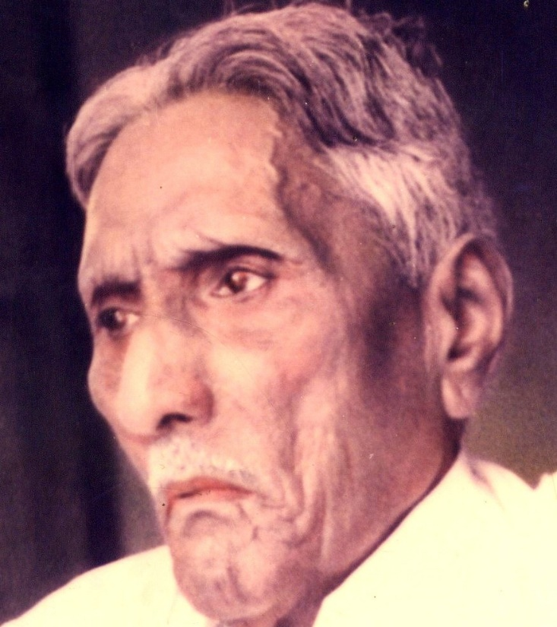

The Bible Mission The Revelation of God to St. M. Devadas The Bible Mission’s Annual Conference

Slide 2
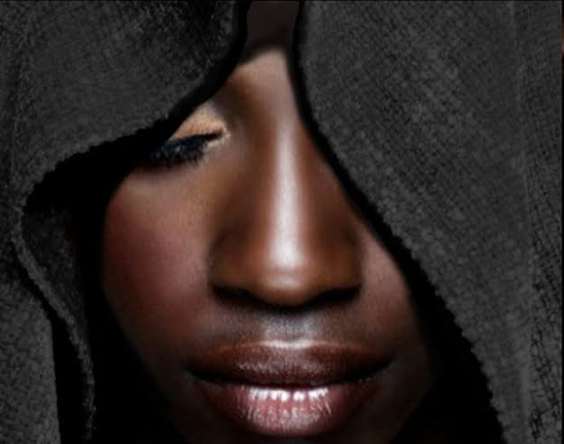
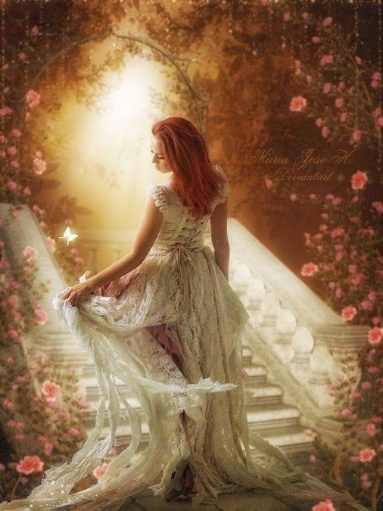
Persecution resulting in the perfection of the Bride in Song of Solomon
Persecution | Perfection
Dark Complexion | More Beautiful
Being Looked upon | Fairest among women
Tanned by the Sun | Fair as the Moon, Bright as the Sun

Slide 3
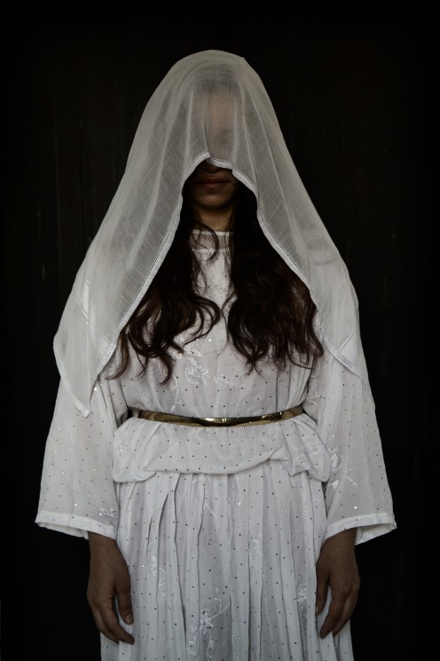
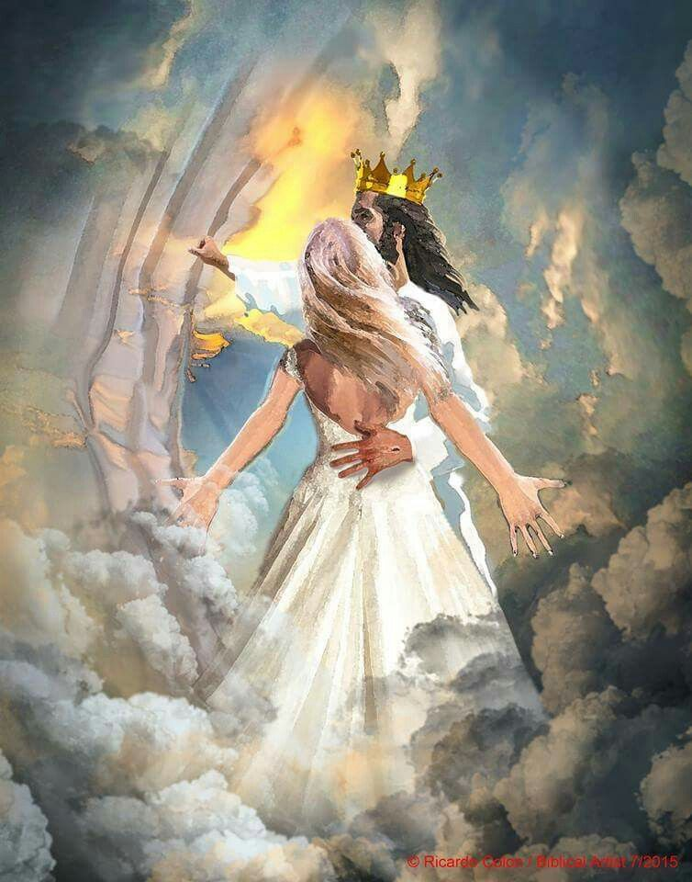
Persecution | Perfection
Anger of Brothers | Praised by the Queens
Keeper of vineyards | An Army with banners
Being veiled and made to wait | Being crowned like Mount Carmel
Being stirred up | Being carried in Solomon’s couch

Slide 4
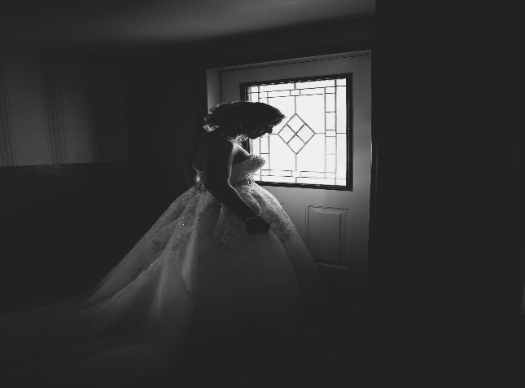
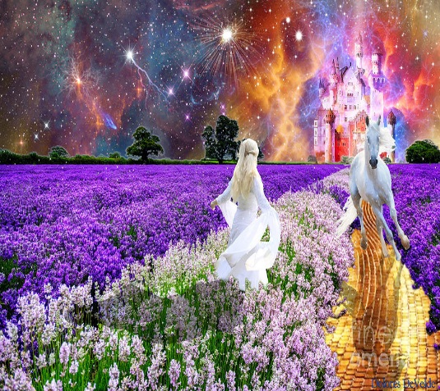
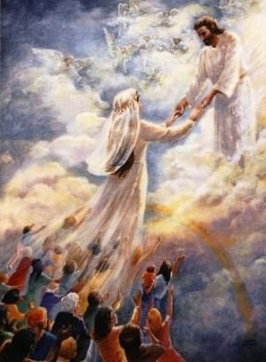
Persecution | Perfection
Winter stagnation | The singing of spring(season)
Foxes and little foxes that ruin vineyards | Pleasant fruits of all manner – New and Old
The slackness of night | Holding the Groom tight without letting him go again
The silent keepers (Un assisting) | Un Quenchable quest to find the Groom

Slide 5
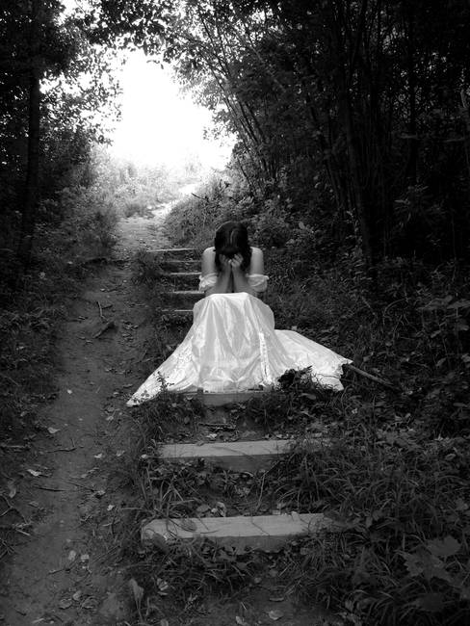
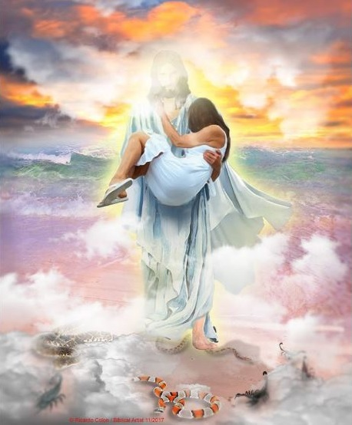
Persecution | Perfection
The scares of night | Being carried in the Couch
The Mountains of Leopards and the dens of Lions | Made as the chariots of Amminadab
Self – Debilities (Fraility 5 ,6) | Sustainable faith (Unconquerable) (6:3)

Slide 6

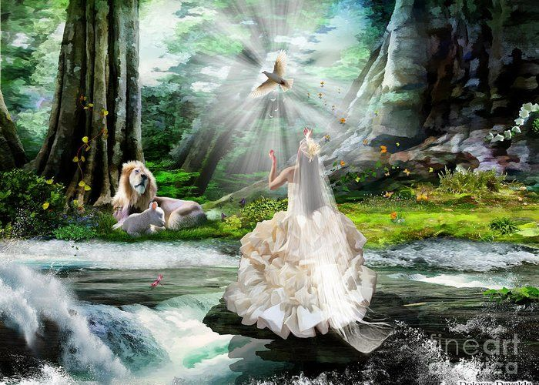
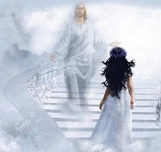
Persecution | Perfection
Blows and wounds | Fair and Pleasant with all the delights.
Being despised (8:1) | 17.Unique state; The only one ; The dearest one (6:9)
Birth pangs (8:5) | To become multitudes (A Holy Nation and Royal Priesthood)

Slide 7
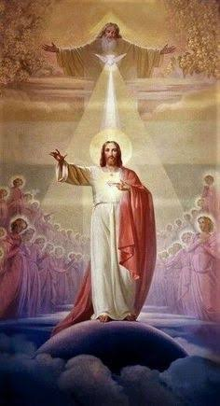
May the Holy Spirit Father Bless and Establish all of us to be His Bride.
AMEN

